Slide 1
Integration Test Patterns
I4SWT

Slide 2
Integration test
Requirements
Accept testing
System specification
System testing
System design
Integration testing
Component design
Unit test
Implement component

Slide 3
Challenges
As we progress ”up the V” (and towards the complete system), …
  Defining a test strategy
  Defining test cases
  Evaluating test results
  Setting up test fixtures
  Setting up test scenarios
  Ensuring test coverage
  Version-controlling tests
…all become more difficult, expensive, time-consuming – and important!

Slide 4
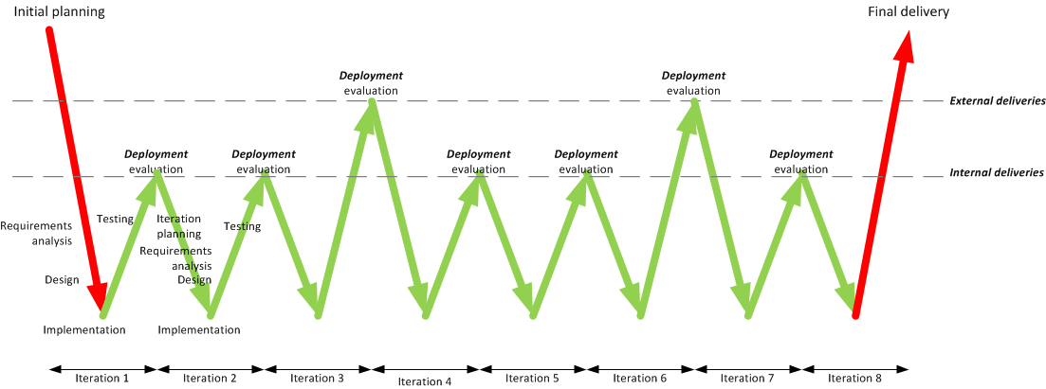
Integration test in an iterative process
IT
IT
IT
IT
IT
IT
IT

Slide 5
Lecture plan
This lecture
  Theory of integration test patterns
  Find the dependency tree
Next lecture
  Integration Test Planning
  Integration Test Case Generation
  IT and CI

Slide 6
Purpose, aim

Slide 7
Purpose, aim
The purpose of integration test is to test the interactions and interfaces between several modules
The aim is to verify correct interaction of the tested modules
  Classes
  Packages
  Components
  Subsystems
Additionally – the interaction between the low level modules (HW drivers) and the actual hardware: that is hardware-software integration
Verification requires 100% interface coverage – is hard to measure and can be hard to obtain

Slide 8
Being smart about integration tests
Integration tests are linked to project ”heartbeat”
  Integration testing usually requires input from several partners, so test planning becomes key.
  Large-scale component integration (at least) at the end of each iteration.
Integration tests requires knowledge of system architecture to partition the system into testable chunks
A strategy!
And a plan!

Slide 9
Prereq’s for starting integration test
Unit testing of all modules is complete
System architecture (dependencies) is known
Integration test plan is defined
  Integrated modules
  System Under Test (SUT) structure?
  Test fixtures / environment
  Test cases – SUT stimuli and expected responses

Slide 10
Getting ready – mapping the dependency tree
Integration test planning is helped along using a dependency tree
  Depicts inter-module dependencies in a tree-like structure
  Does not depict an inheritance hierarchy, layering or the like
A depends-on B, C and D
B depends-on E and F
C depends-on F and G
D depends-on H and I
Some dependencies are obvious from sequence diagrams, object diagrams, state charts, etc.
Others require inspection (members, parameter types, ..)
Loops can be broken using stubs

Slide 11
DT design rules
Dependency tree is a new type of diagram
DT is not a (official) UML diagram type
Dependencies always goes from the bottom of the dependent module to the top of the one it is dependent on!
That way arrows are not needed
Dependencies never goes sideways (horizontal)
Move modules down to avoid this
Show loops as loops!

Slide 12
Integration test patterns
Integration test patterns are used to plan and execute the integration tests.
This session covers the following patterns
  Big Bang Integration
  Bottom-up Integration
  Top-down Integration
  Collaboration Integration
  Sandwich Integration

Slide 13
Big Bang Integration

Slide 14
Big Bang Integration
”Fire it up, see it fail”
Works (sometimes) for small, low-complexity, stable, systems
Only possible late in
development –
errors costly to fix
Works (sometimes) for small, low-complexity, stable, systems
Very low probability of detecting errors
Very little feed-
back

Slide 15
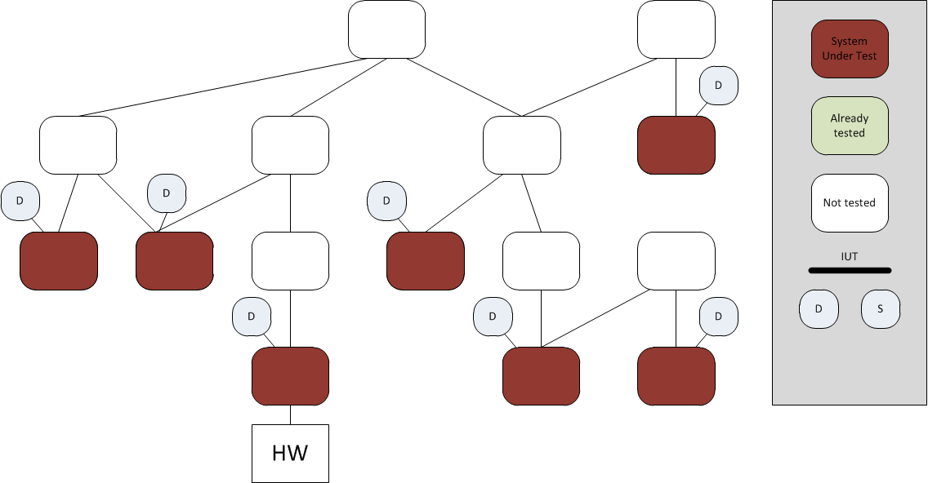
Bottom-up Integration

Slide 16
Bottom-up Integration

Slide 17
Bottom-up Integration

Slide 18
Bottom-up Integration

Slide 19
Bottom-up Integration

Slide 20
Bottom-up Integration
Reflects very ”engineering-like” mindset
No (few) stubs to develop
Requires many drivers at different levels
Easy to cover interfaces at all levels
Postpones test of critical control com-ponent interfaces

Slide 21
Top-down Integration

Slide 22
Top-down Integration

Slide 23
Top-down Integration

Slide 24
Top-down Integration

Slide 25
Top-down Integration

Slide 26
Top-down Integration
Needs lots of stubs (OK with isolation framework)
Early feedback on controller compo-nents
Hard to exercise low-level interfaces from the top
Facilitates concurrent HW and SW development

Slide 27
Collaboration Integration

Slide 28
Collaboration Integration

Slide 29
Collaboration Integration

Slide 30
Collaboration Integration

Slide 31
Collaboration Integration

Slide 32
Collaboration Integration

Slide 33
Collaboration Integration
Needs lots of stubs (OK with isolation framework)
Intuitive for users (may follow use cases)
Hard to exercise low-level interfaces
Participants not exercised separa-tely – mini Big-Bang!
Especially useful for higher-level system tests (component, subsystem)
Models iterative development with UCs as unit

Slide 34
Sandwich Integration

Slide 35
Sandwich Integration

Slide 36
Sandwich Integration

Slide 37
Sandwich Integration

Slide 38
Sandwich Integration

Slide 39
Sandwich Integration

Slide 40
Sandwich Integration
Takes lots of planning
The best of top down and bottom up
Many of the disadvantages of TD and BU are alleviated

Slide 41
Best practices
Automate, automate, automate
  Higher complexity → lower probability
  Use High Frequency integration: Nightly CI builds for each test scenario to check integration (common code repo)
  Use Unit Test and isolation frameworks as much as possible
Easier to code stubs than drivers
Use a little bit of all patterns (except Big Bang)

Slide 42
Integration test with Continuous Integration
IT
IT
IT
IT
IT
IT
IT
IT
IT
IT
IT
IT
IT

Slide 43
Dependency Tree – What?
The Dependency Tree must reflect the dependencies in the REAL code!
It does NOT show interfaces!
Search for usage of base classes
  They may be used implicitly, e.g. as parameters
  Include all derived classes!
Search for usage of interfaces
  They may be used, e.g. as parameters
  Replace them with all implementations!

Slide 44
Step 1 – Find the Dependency tree!
Class diagrams (static information)
  Remember polymorphic classes
  Remember interfaces and base classes
Sequence diagrams (behavioral information)
Test cases for units
  Which interfaces were defined
  Which IFs were faked
Call trees? Manually or automated tool?
  Reveals "tool classes", objects passed around
Dependency tree generator tool?

Slide 45
Dep. Tree trap – bidirectional association
Choose the one that fits the flow of the system best, or gives the best integration plan
In some steps, you may need both the real and a fake version of one of the classes
Don't panic – just do it!

Slide 46
Dep. Tree trap – events
A C# event is a dynamic bidirectional association
Look at the flow of actions through the system
Buttons and timers are examples
Timers are of one of the types of classes it is a good idea to fake as long as possible
Often one of the directions is only for setting up the event connection; that is often the least important one

Slide 47
Dep. Tree trap – inheritance – dependency inversion
Integration planning concerns the integration of the real code.
Dependency tree must show the dependency between the actual code as implemented!
Not between abstract interfaces!
Often this is reflected in the inversion of the inheritance hierarchy from the class diagram to the dependency tree

Slide 48
Exercise
Find the dependency tree for the Microwave Oven System.
Look for dependencies using the list on the previous slide
Remember – it is the actual code/modules/classes that must be integrated!

